Slide 1
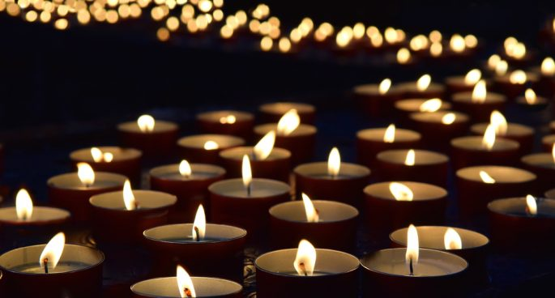
Transgender Day of Remembrance
2020

Slide 2
Who is Transgender?
Transgender is a broad term that can be used to describe people whose gender identities, expression and/or lived experiences differs from the sex they were assigned at birth.
“Trans” is often used as shorthand for transgender.
Some transgender people identify as neither a man nor a woman, or as a combination of male and female, and may use terms like non-binary, gender non-conforming, or gender expansive to describe their gender identity.

Slide 3
Who is Transgender?
As with any language that attempts to succinctly capture the human experience, the usage of these terms and sense of identity among the transgender community vary widely.
It is important to use respectful terminology, and treat transgender people as you would treat any other person. This includes using the name the person has asked you to call them as well as the pronouns they want you to use. Using correct identifiers and pronouns isn’t just about accuracy – it’s about affording all individuals the respect and dignity that everyone deserves.

Slide 4
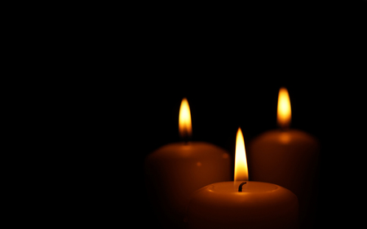
In Memory Of...

Slide 5
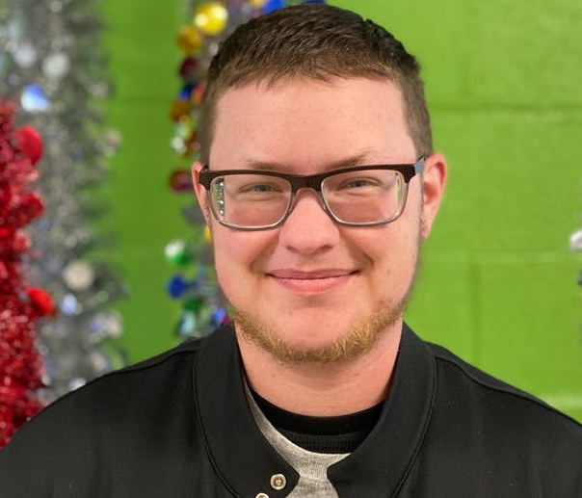
Dustin Parker, 25
Dustin was a married father of four and a founding member of Oklahomans for Equality-McAlester Chapter: Southeastern Equality. His wife Regina shared that he was such an amazing and special person. He was incredibly generous, kind, intelligent, and empathetic. He had so many things that he wanted to do and achieve in his life. He was everyone’s shoulder to cry on and the best listener. Dustin was working as a cab driver in McAlester, Oklahoma when he was killed by gunfire early on January 1, 2020.

Slide 6
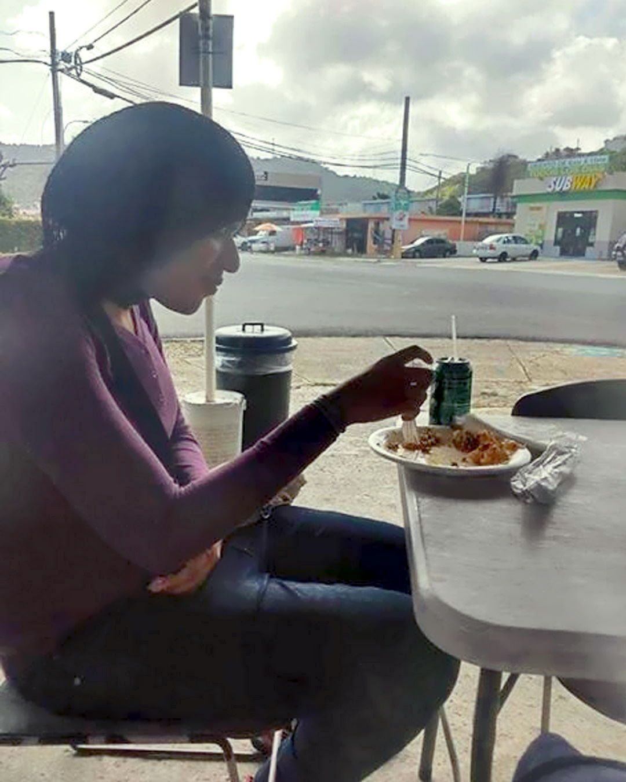
Neulisa Luciano Ruiz, 28
Members of Neulisa’s community knew her as “humble” and “noble”. She had dreams, hopes, hobbies, and was experiencing homelessness, further highlighting the ways a toxic mix of transphobia and misogyny conspire to put the transgender community at risk of extreme violence. On February 24, 2020 in Toa Baja, Puerto Rico, Ruiz appeared to have been targeted by her killers after a social media post claimed a homeless transgender woman was using the women’s restroom. Her attackers followed her in a car, filmed the brutal killing and posted it online. No arrest has been made.

Slide 7
Yampi Méndez Arocho, 19
On social media, Arocho shared his love for basketball and the NBA -- donning Miami Heat apparel. The biography line on his Facebook reads simply, “Humility Prevails.” On March 5, 2020 in Moca, Puerto Rico, Arocho had been attacked by a woman five hours before he was later found dead in a local park with four gunshot wounds. Local LGBTQ advocates called for authorities to thoroughly investigate this crime, including an investigation into whether or not this was a bias-motivated crime.

Slide 8
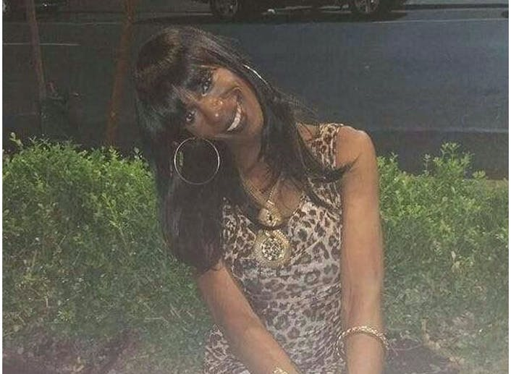
Monika Diamond, 34
Through her work in the Charlotte LGBTQ and nightlife community and the International Mother of the Year Pageantry System, Diamond spent her adult life creating community and spaces for LGBTQ people in Charlotte and beyond to come together and celebrate their lives. She was a chosen mother to countless. She was a business owner, a loving friend and she did not deserve to have her life taken from her. Monika was killed in Charlotte, North Carolina on March 18, 2020. A suspect has been arrested and faces a charge of murder.

Slide 9
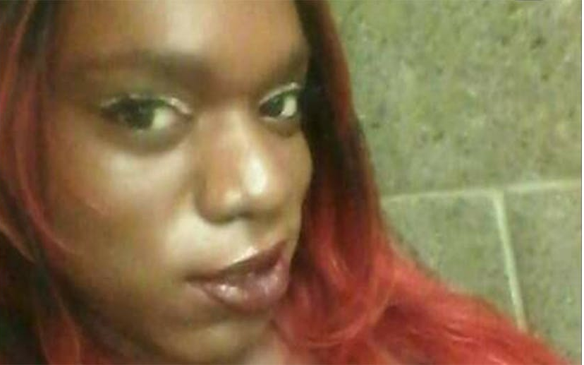
Lexi “Ebony” Sutton, 33
Lexi’s friend Lavonia Brooks shared: “I really looked up to her because of her tolerance and respect. Lexi had a beautiful heart, she was very gifted.” Brooks also noted that Lexi loved poetry, makeup and fashion. Lexi engaged in sex work and it is believed her attacker also did. Lexi was fatally stabbed at work in Harlem River Park in New York on March 28, 2020. No arrest has been made.

Slide 10
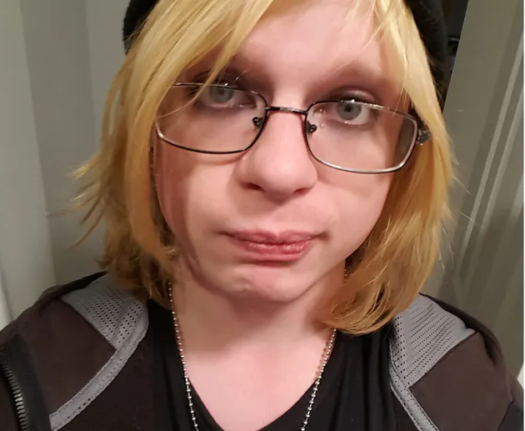
Johanna Metzger, 25
Johanna Metzger is from Pennsylvania and was at a recovery center in Baltimore. Her mother says she taught herself how to play multiple instruments and was a college graduate. Johanna was killed in Baltimore, Maryland on April 11, 2020.

Slide 11
Penélope Díaz Ramírez, 31
“Penélope did not deserve to die. Transgender people do not deserve to die. Every single advocate, ally, elected official and community member must stand up in light of this horrific news and say ‘No more.’ What we are doing is not enough,” said Tori Cooper, HRC Director of Community Engagement for the Transgender Justice Initiative. She was killed at the Bayamon correctional complex in Puerto Rico on April 13, 2020. Charges for murder and destruction of evidence were filed.

Slide 12
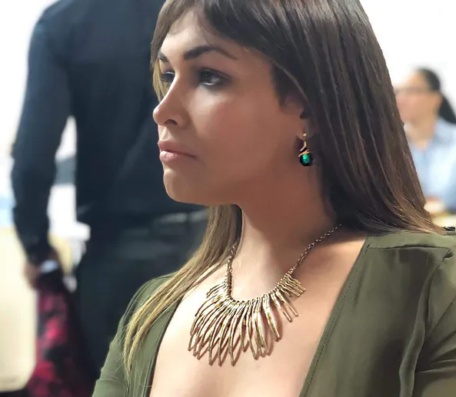
Serena Angelique Velázquez Ramos, 32
Ramos was visiting Puerto Rico on vacation, and was set to return to her home in Queens, New York, at the end of the month. On Facebook, she listed that she graduated from the Universidad del Turabo. She loved her pets, two cats and a dog. She also had a passion for exploring her spiritual side through tarot card readings; she maintained a YouTube channel where she taught audiences about her passion. Loved ones are mourning her death, calling her “full of life,” a “happy person” and a “sincere friend.” She was killed on April 21, 2020. Two young men were arrested for her murder.

Slide 13
Layla Pelaez Sánchez, 21
Sanchez had recently moved to Puerto Rico, and was living in the Tejas neighborhood in Piedras. Layla had hopes to change her driver’s license to be identified as a woman - as her friend Serena had done a few months earlier. She was killed alongside Serena Angelique Velázquez Ramos on April 21, 2020.

Slide 14
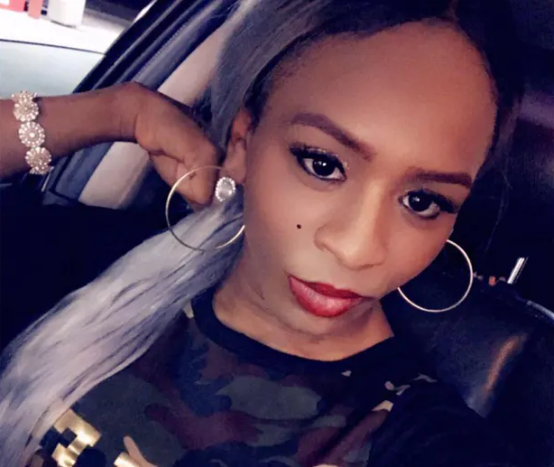
Nina Pop, 28
Nina Pop, 28, worked at a fast-food restaurant in Sikeston and was well-known in the area, according to KFVS. “She was always happy,” her friend Emory McCauley told the station. Pop was stabbed to death on May 3, 2020 in Sikeston, Missouri, and was in her apartment. No arrest has been made.

Slide 15
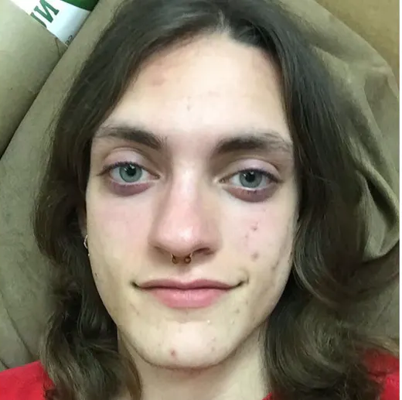
Helle Jae O’Regan, 20
Helle has been described as a proud trans woman, who embraced her identity. On the Trans Day of Visibility she posted to her Instagram account where she shared pictures of her transition. 'I wasn't going to post anything but it's #transdayofvisibility so I decided I will. I was looking at the pictures I used to take before I transitioned versus now and it made me realize I'm way happier than I used to be. I love myself now. Thank you to everyone who's ever supported me and to anyone who hasn't I hope you come around. I'm happy and proud to be myself.' She was identified as the victim of a workplace rampage that claimed her life and injured two others in San Antonio on May 6, 2020.

Slide 16
Jayne Thompson, 33
Thompson’s friend shared that she was in a “tough spot” after moving to Bisbee; she had recently begun transitioning and was looking for a new community and a fresh start. He described Thompson as quiet on the surface, which is how many others remembered her, but said she was funny and lively: “If she let you in and you were able to get to know her.” Jayne was shot to death by a patrol trooper in Mesa County, Colorado on May 9, 2020. No charges were filed for Thompson’s death.

Slide 17
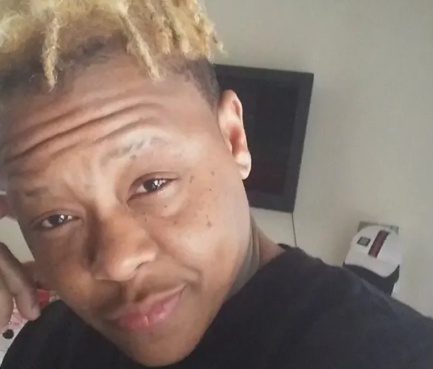
Tony McDade, 38
McDade used the nickname “Tony the Tiger” with friends. He was a Gemini. His loved ones shared, “You have such a big heart... Just your energy would lift my spirits.” Tony McDade was shot and killed by an unnamed white police officer in Tallahassee, north Florida, on May 27, 2020. He died shortly afterwards in hospital, his death marking Florida’s third fatal police shooting in the last two months.

Slide 18
Selena Reyes-Hernandez, 37
“We have lost a beloved member of our extended trans family because of hate and violence -- hate and violence that has corrupted our country’s soul and that shatters lives and futures every day,” said Tori Cooper, HRC director of community engagement for the Transgender Justice Initiative. Reyes-Hernandez was shot and killed in Chicago, Illinois on May 31, 2020 because she told her assailant that she was trans. The suspect was charged with first-degree murder.

Slide 19
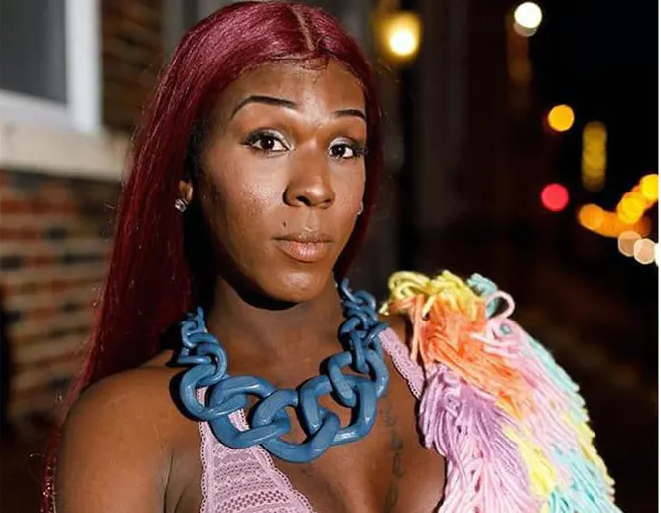
Dominique “Rem’mie” Fells, 27
A friend of Fells said Dominique faced what she called challenges and “demons." Fells was making plans to go back to school with dreams of being a fashion designer, her friend said. She was also a dancer and artist, a vibrant person, making it that much harder for those who knew her to accept that she’s the latest victim of violent crime. She was killed in Philadelphia, Pennsylvania, on June 9, 2020. Local police have already ruled her tragic death a murder and are investigating.

Slide 20
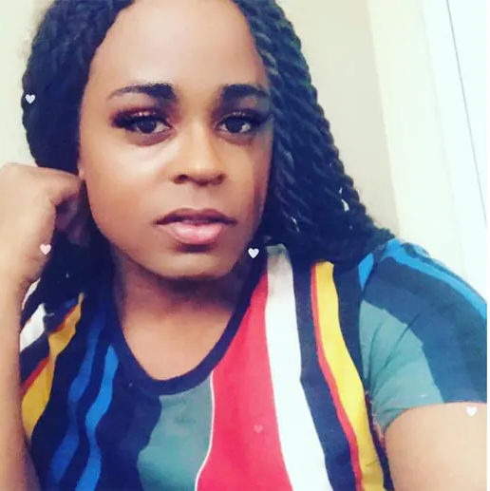
Riah Milton, 25
Milton worked as a home health aide and studied at the University of Cincinnati. She was a loving sister and aunt, often posting photos of her family. In March, she posted the status “Never been scared to struggle... Imma get it eventually” -- a comment highlighting her resilience and optimism as a person facing a transphobic, misogynist and racist society. She was shot dead during a robbery in Cincinnati, and died on June 9, 2020 in Liberty Township, Ohio. Two suspects were arrested in connection to Milton’s death. One suspect remains at large.

Slide 21
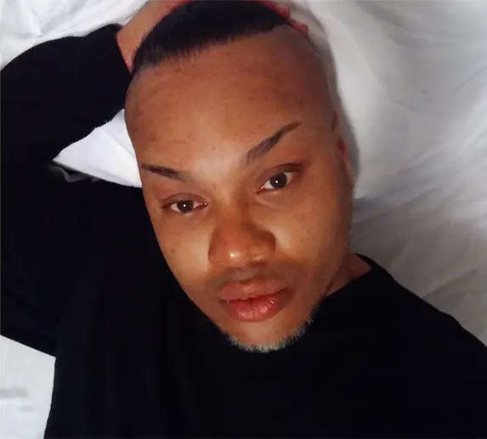
Brian “Egypt” Powers, 43
As a child, Powers dreamed of becoming a backup dancer for Janet Jackson or Paula Abdul. Powers worked at a local catering company and is remembered for wearing long, colorful braids -- “unicorn braids,” as Powers called them. Brian Powers was found dead on June 13, 2020 from a gunshot wound on the sidewalk of a church near the University of Akron. Nearly two months after the murder of a transgender man in Akron, police still have no leads.

Slide 22
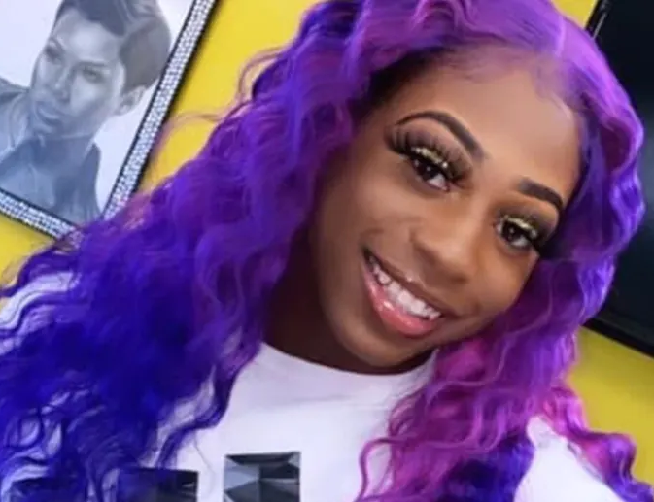
Brayla Stone, 17
Brayla was someone who always held space for others to be themselves and express their identities. She was a child, just beginning to live her life...a child of trans experience...a young Black girl who had hopes and dreams, plans and community. She was found killed on June 25, 2020 in Little Rock, Arkansas. The Sherwood Police Department is investigating the incident as a homicide.

Slide 23
Merci Mack, 22
Merci was a 22-year-old Black trans woman living in Dallas. She had a job, a car, family, and friends. Her social media posts were playful, blunt, and hopeful. On her Facebook, Mack shared that she liked baking cookies at home. She loved relaxing in the jacuzzi. She posted about how excited she was to return to her job at a local restaurant, which had been closed due to COVID-19. On the final day of Pride month, June 30, 2020, she was found dead from gunshot wounds in an apartment complex parking lot in Dallas, Texas.

Slide 24
Shaki Peters, 32
Shaki’s friend shared in an interview: “Shakiie would provide moments of joy and laughter that sustained us. Whenever you’re facing the systemic issues we face as Black people, that triple identity of being a Black, trans woman, it’s easy to just give up or not want to get out of bed, but you never saw Shakiie do that. She definitely was an inspiration in how she navigated life.” She was killed on July 1, 2020 in Amite City, Louisiana. Local police have identified a person of interest in the case.

Slide 25
Bree Black, 27
Bree was killed in Pompano Beach, Florida, on July 3, 2020 of an apparent gunshot wound. Black Lives Matter Alliance Broward created an altar and hosted a gathering to remember Bree. Around 25 people gathered with flowers and candles to remember her, and protestors marched to Pompano Beach City Hall after the gathering while chanting “No Justice, No Peace.”

Slide 26
Summer Taylor, 24
Taylor worked full time at Urban Animal veterinary hospital. One friend described Taylor as “a blinding light in an otherwise dark world.” A coworker noted that Taylor had been a frequent presence at the protests, saying, “Summer has been there since Day One standing up for Black lives. Staying out all day and night, while still working full time taking care of animals. Summer talked to me about the protests, and how incredible it was to be a part of something so huge. A part of history.” Taylor was killed after a car drove into a crowd of protestors in Seattle, Washington, on July 4, 2020. Taylor was participating in the Black Femme March in solidarity with Black Lives Matter and against police brutality.

Slide 27
Marilyn Cazares, 22
Marilyn Cazares’ aunt said she “loved to sing and dance” and “never bothered anyone.” On Twitter, community members are remembering Cazares, who was known in the community for her colorful clothing. Her cousin -- who notes that Cazares continued to use her birth name with family -- reflected on a memory of her cousin “jamming out to Billie Jean like the badass queen she was” while in the car. Cazares was found dead after being stabbed and burned on July 13, 2020 in Brawley, California. Police are investigating the incident as a homicide, although they currently have very little information about the circumstances.

Slide 28
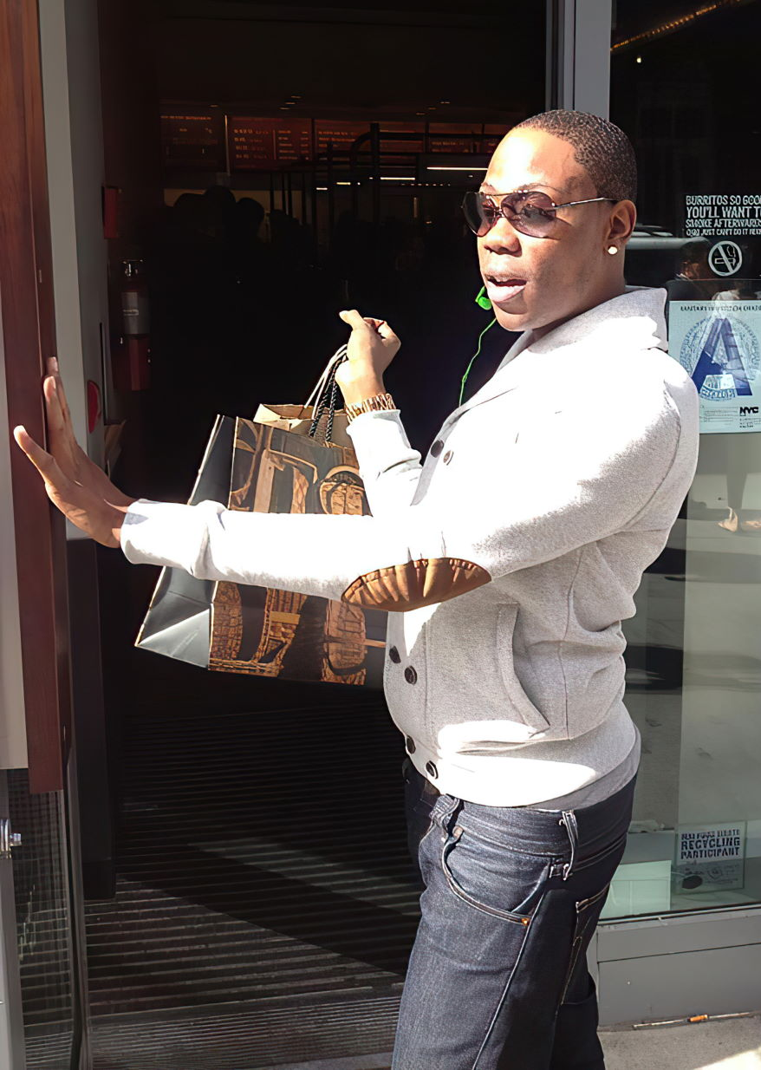
Tiffany Harris “Dior H Ova”, 32
Ova loved fashion -- listing her career as a personal shopper and posting photos with luxury fashion brands that she loved. She also enjoyed watching TV dramas, such as “Desperate Housewives,” “Nip/Tuck” and “Sex and the City.” She noted her hometown as Kingston, Jamaica. Tiffany was stabbed in the hallway of an apartment building in the early hours of July 26, 2020 in Bronx, New York. A man she had a relationship with is being sought for questioning.

Slide 29
Queasha D Hardy, 22
Hardy, a hairstylist, was extremely loved by her community. On Facebook, many loved ones of Hardy are sharing memories of their time together. One person posted a video of Hardy dancing spontaneously with friends. Another friend remembered Hardy doing her hair and the joy she felt at “looking fly for [her] baby shower.” Others describe her as loyal, loving, “always smiling,” “the life of all parties” and “truly one of a kind. Her body was discovered on July 27, 2020 in Baton Rouge, Louisiana, after she allegedly sustained fatal gunshot wounds. She is reported to have passed away at the scene of the crime, and police have yet to identify a suspect.

Slide 30
Aja Raquell Rhone-Spears, 32
Rhone-Spears was incredibly close to her family, posting photos with her father and playful statuses related to conversations she had with family members about cooking. She called out instances of racial injustice, especially violence by police, and advocated for a world free from white supremacy. She studied at the University of Nevada, Las Vegas, and was the owner and founder of International Barbie, a Portland-based clothing brand. Neighbors and loved ones have posted about Rhone-Spears online, calling her a “vibrant personality.” Aja was one of two people stabbed on July 28, 2020 in Portland, Oregon.

Slide 31
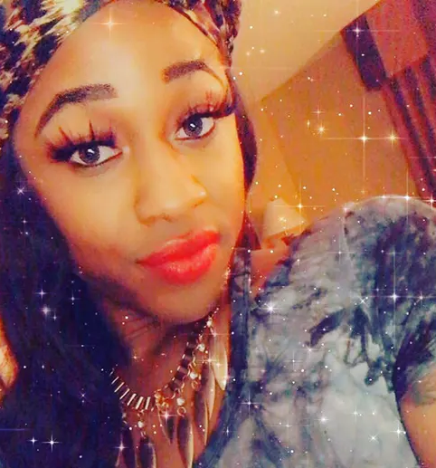
Kee Sam, 24
Friends have been remembering Kee Sam on her Instagram page, commenting with heartfelt messages including “this can’t be real,” “I will miss you… you know you in my heart forever” and “rest in love.” Sam was found suffering from a gunshot wound and subsequently died in a hotel on NE Evangeline Thruway on August 12, 2020 in Lafeyette, Louisiana. A 16-year-old has been arrested in connection with the shooting.

Slide 32
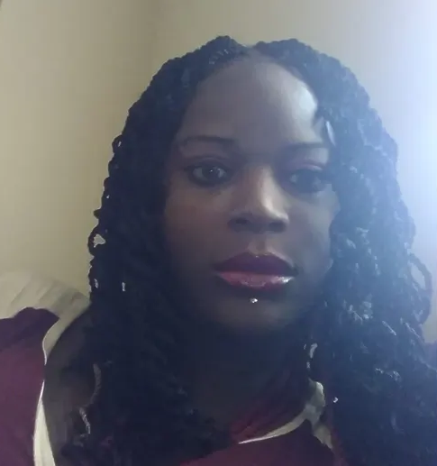
Aerrion Burnett, 37
“She was a goddess,” said Burnett’s friend. “If you wanted to have a good day, you need to smile, Aerrion was the person you wanted by your side.” Another friend remembered her as the “life of the party.” Her sister shared that Aerrion was a beautiful soul. She always stayed the same, and kept the same attitude. Burnett was found dead of a gunshot wound in Independence, Missouri on September 19, 2020. Detectives in Independence continue to seek tips of this murder.

Slide 33
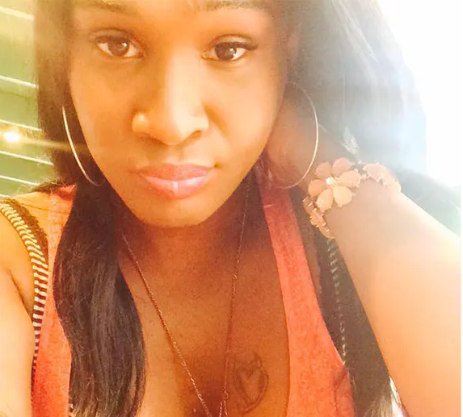
Mia Green, 29
Friends remember Mia on social media. One friend shared, “Her smile was so perfect and so contagious. She made me laugh.” Another said that she was “such a sweet spirit.” Others shared that her death was heartbreaking, and called for justice. Mia was killed in Philadelphia, Pennsylvania on September 28, 2020. She was found suffering from a gunshot wound and was transported to a hospital, where she passed away. Police say that the suspect is facing murder charges.

Slide 34
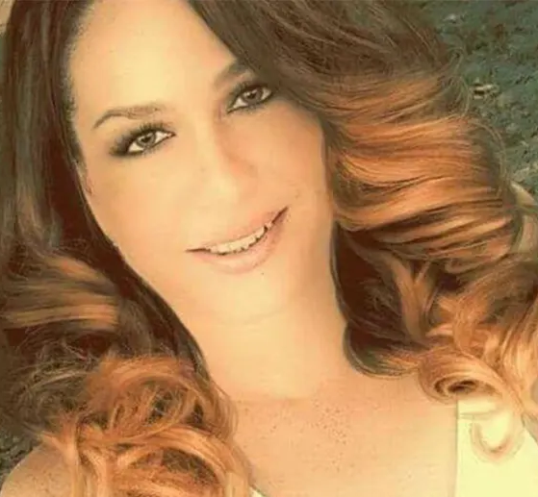
Michelle Michellyn Ramos Vargas, 35
Vargas was studying to become a nurse at Ponce Paramedical College. She was killed on September 30, 2020 in Puerto Rico and was found dead of multiple gunshot wounds in the Sabana Grande Abajo neighborhood, where she lived.

Slide 35
Felycya Harris, 33
Felycya was an interior decorator and ran her own company where she enjoyed lending her eye to improve the surroundings of others, and made others feel comfortable in their own space. She said she could do “just about anything with decorating,” which she learned from her late grandmother. Friends remember her “laugh. The smile -- the smiles. The talks. The arguments. The attitudes. Everybody is going to remember who Felycya Harris is.” Based on her social media posts, she enjoyed dance, fashion and style, had a bright sense of humor and was full of life. Harris was shot and killed in Augusta, Georgia on October 3, 2020.

Slide 36
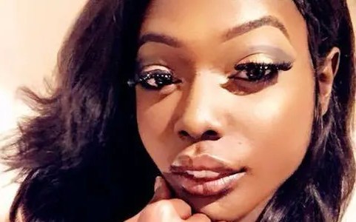
Brooklyn Deshuna, 20
Brooklyn attended Bossier Parish Community College and studied cosmetology. Friends are remembering Brooklyn on social media, with one friend saying that she was “genuinely a good person,” and another sharing “you didn’t deserve this… I’m heartbroken.” Friends and family are also calling for justice. Brooklyn was killed as a result of a gunshot wound in Shreveport, Louisiana on October 7, 2020.

Slide 37
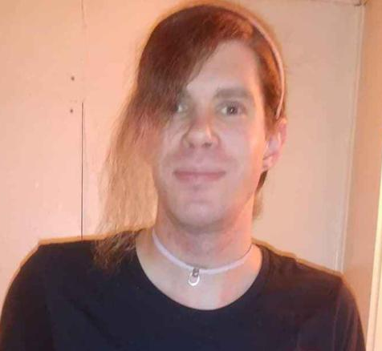
Sara Blackwood, 39
Sara enjoyed playing video games, including RPGs, and was a fan of the show “My Little Pony,” sharing many images, art and memes from the show on her Facebook page. Another friend shared, “she always had a place in my heart. Still does and I don’t see that ever changing.” While walking home, Sara was shot and was transported to a hospital on October 11, 2020 in Indianapolis, Indiana. Tragically, she died on National Coming Out Day.

Slide 38
Angel Unique, 25
“Everybody that knew Angel, knew that she was very funny, very nice to everybody she met,” said her friend in a video for ABC 24, a local news station in Memphis. A member of Angel’s family remembered her on Facebook as “such a bright person [with] a positive spirit.” Angel was also a licensed cosmetologist. She was killed in the early morning of October 25, 2020 in Memphis, Tennessee as a result of a gunshot wound. Currently, no suspect information is available.

Slide 39
We remember the lives lost
At least 34 individuals were killed in the United States in 2020
At least 25 individuals have been killed in the United States since the beginning of 2019
At least 22 individuals were killed in the United States in 2018
We say “at least” because the numbers are very likely an underrepresentation of the number of transgender people who have been killed.

Slide 40
We honor the lives lived
Even in the face of physical danger, hatred and discrimination – sometimes ruthlessly endorsed and enforced by those at the highest level of our government – transgender Americans live courageously and overcome unjust barriers in all corners of our country.

Slide 42
Sources
GLAAD
Doubly Victimized, Reporting on Transgender Victims of Crime. https://www.glaad.org/publications/transgendervictimsofcrime
Human Rights Campaign
A National Epidemic: Fatal Anti-Transgender Violence in America in 2018. https://www.hrc.org/resources/a-national-epidemic-fatal-anti-transgender-violence-in-america-in-2018
Violence Against the Transgender Community in 2019. https://www.hrc.org/resources/violence-against-the-transgender-community-in-2019
National Center for Transgender Equality. https://transequality.org/

